Slide 1

Cloud Native Batch Processing
Michael Minella
@michaelminella

Slide 2


CLOUD NATIVE
BATCH PROCESSING

Slide 3

MICHAEL MINELLA
Lead – Spring Batch &
Spring Cloud Task
JSR-352 - Expert Group Member
Author – Pro Spring Batch
Speaker - JavaOne Rockstar
Java Champion
Podcast - OffHeap Curmudgeon
Twitter - @michaelminella or
@OffHeap

Slide 4


Slide 6

SLIDES AND CODE
ARE ON GITHUB
https://github.com/mminella/cloud-native-batch

Slide 7

Notes:
Please ask questions when you have them

Slide 8


LAY OF THE LAND

Slide 9

SPRING FRAMEWORK

Slide 10

SPRING BATCH

Slide 11

SPRING CLOUD

Slide 12
SPRING CLOUD TASK

Slide 13

SPRING CLOUD DATA FLOW

Slide 14

Notes:
Today we’re going to look at the most exciting area of IT

Slide 15

Notes:
Batch processing

Slide 16
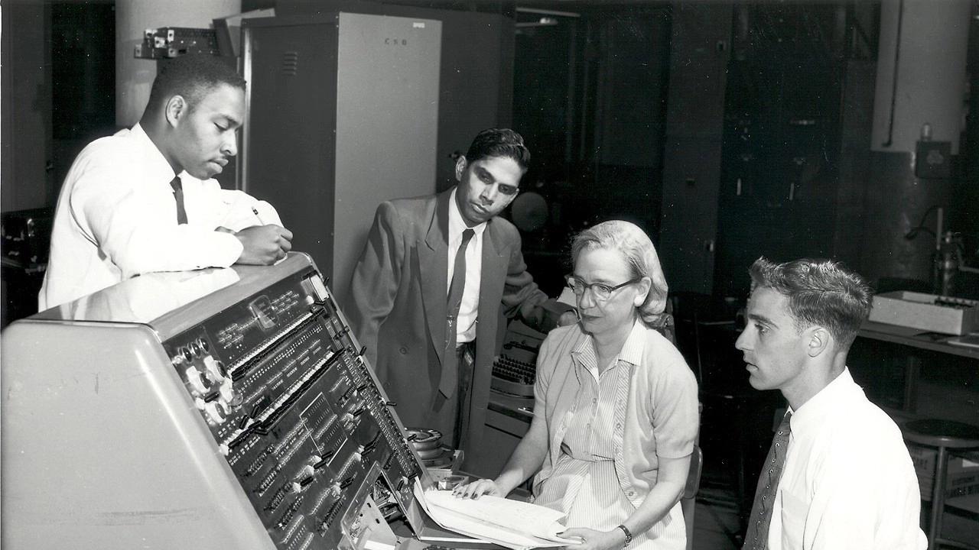
Notes:
While batch processing may be old

Slide 17

BATCH PROCESSING
IS STILL RELEVANT
Notes:
All joking aside, new paradigms still need batch processing:
ETL
Orchestration of workloads
Data Science
IOT

Slide 18

MODERN PATTERNS AND TOOLS
MAKE BATCH A POWERHOUSE

Slide 19




Amazon S3
Import Process

Slide 20
SPRING BATCH

Slide 21
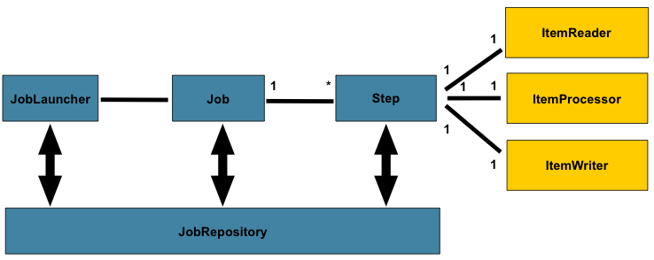
PROVIDES BASIC
BATCH FUNCTIONALITY
Notes:
Spring Batch is 9 years old
A bedrock technology in modern enterprises in every vertical

Slide 22

SPRING BATCH 4.1.1.RELEASE

Slide 23
@SpringBatchTest
Notes:
Autoconfigures:
JobLauncherTestUtils
JobRepositoryTestUtils
JobScopeTestExecutionListener
StepScopeTestExecutionListener

Slide 24
@EnableBatchIntegration
Notes:
Provides builders for both remote partitioned and remote chunking workloads when using Spring Integration for communication

Slide 25
[
{
"isin": "123",
"quantity": 1,
"price": 1.2,
"customer": "foo"
},
{
"isin": "456",
"quantity": 2,
"price": 1.4,
"customer": "bar"
}
]
Notes:
JsonItemReader
Similar to StaxEventItemReader, but for JSON
Parsers for Jackson and Gson are both supported out of the box

Slide 26
@Bean
public BeanValidatingItemProcessor<Person> bvip(){
BeanValidatingItemProcessor<Person> bvip =
new BeanValidatingItemProcessor<>();
bvip.setFilter(true);
return bvip;
}
Notes:
Bean validation based validation

Slide 27
Notes:
JSR-305 support (Null safety)
FlatFileItemWriterBuilder enhancements
Simplified the configuration of writing either a delimited or fixed width file
Other bug fixes, etc

Slide 28
Amazon S3
Import Process

Slide 29
SPRING BATCH 4.0
Notes:
New features provide added robustness

Slide 30


FlatFileItemReader
JdbcBatchItemWriter
EnrichmentItemProcessor
S3JDBC Job
load
REST Service

Slide 31
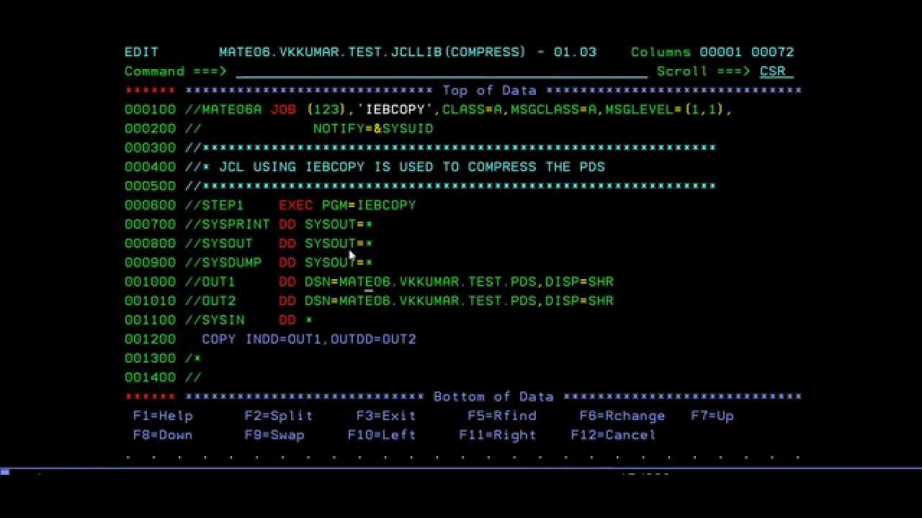
SHOW ME THE
CODE!

Slide 32
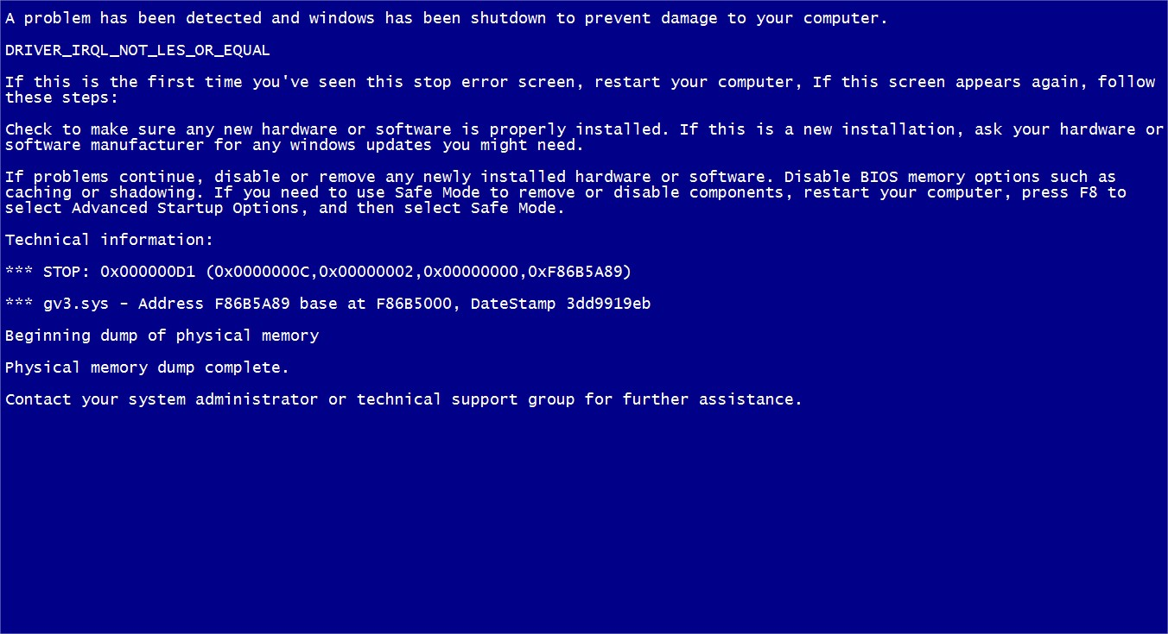

Slide 33
CIRCUIT
BREAKER

Slide 34
SHOW ME THE
CODE!

Slide 35

Notes:
How do we configure our app?

Slide 36
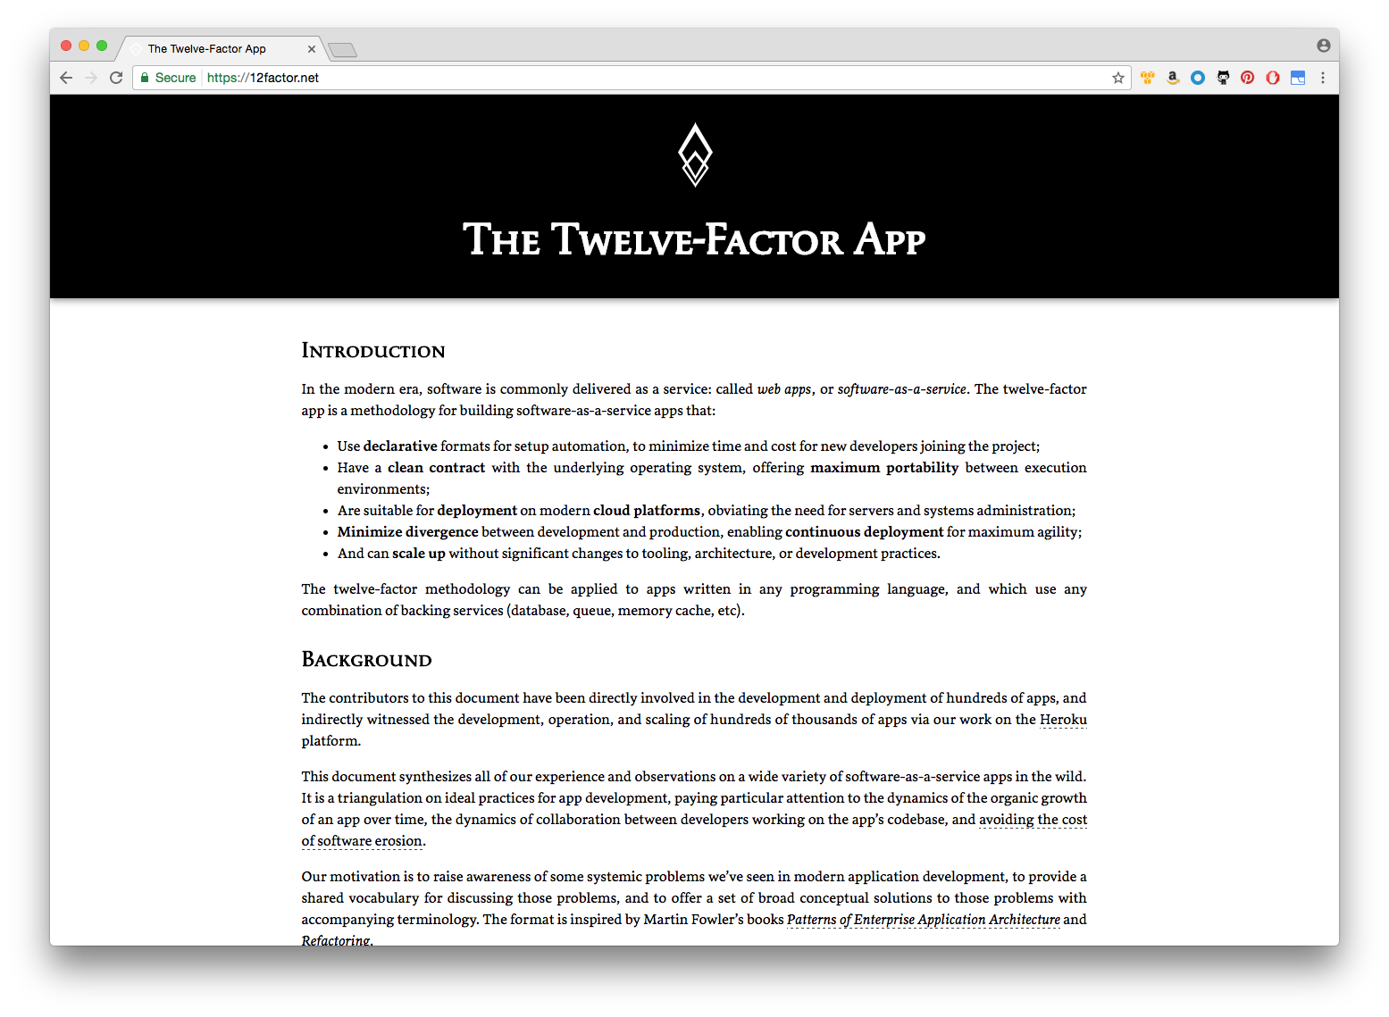
CODE AND CONFIG
SEPARATION

Slide 37

MULTIPLE
APPROACHES

Slide 38
SPRING CLOUD CONFIG SERVER

Slide 39
SPRING CLOUD EUREKA SERVER

Slide 40
Amazon S3
Import Process
Spring Cloud
Config
Spring Cloud
Eureka
REST Service

Slide 41
SHOW ME THE
CODE!

Slide 42

HOW DO WE
SCALE THE APP?

Slide 43
SCALING SPRING BATCH

Slide 44
1
PARALLEL
STEPS

Slide 45
2
MULTITHREADED
STEPS

Slide 46
3
PARTITIONING

Slide 47
4
REMOTE
CHUNKING

Slide 48

WE’LL USE
PARTITIONING

Slide 49
PARTITIONING VIA
SPRING CLOUD
TASK

Slide 50
Amazon S3
master
worker
worker

Slide 51
SHOW ME THE
CODE!

Slide 52

HOW DO WE
ORCHESTRATE?

Slide 53
SPRING CLOUD DATA FLOW

Slide 54
CLOUD NATIVE ORCHESTRATION
TOOL FOR MICROSERVICES

Slide 55

LAUNCH VIA REST,
STREAMS, OR ON DEMAND

Slide 56
SHOW ME THE
CODE!

Slide 57
CLOUD NATIVE WITH SPRING

Slide 58
ALLOW YOU TO TAKE
BATCH PROCESSES

Slide 59
AND DEPLOY
THEM TO THE CLOUD

Slide 61

Learn More. Stay Connected.
Case Study of Batch Processing With
Spring Cloud Data Flow Server in Cloud Foundry
Wednesday - 5:40pm - Room 2005
@s1p
#springone

